Slide 1
Special Branch
Bangladesh
Hello SB App

Slide 2
Introduction
Introduction
Special Branch is one of the prime intelligence agencies of the country.
Although Special Branch is an intelligence organization it provides frontline Immigration Services, Verification of Passports, Security Clearance for Foreigners & Foreign Entities, Verification for Dual Nationality & Visas and Registration for the foreigners etc.
Services Through Hello SB App:
Passport Verification Queries
Immigration Services
Queries of Visa Related Verifications
Foreigners Registration, NVR & Dual Nationality Queries
Security Clearance for Foreign Nationals & Agencies
Information about Latest Rules, Regulations, Circulars & Concerned laws.

Slide 3
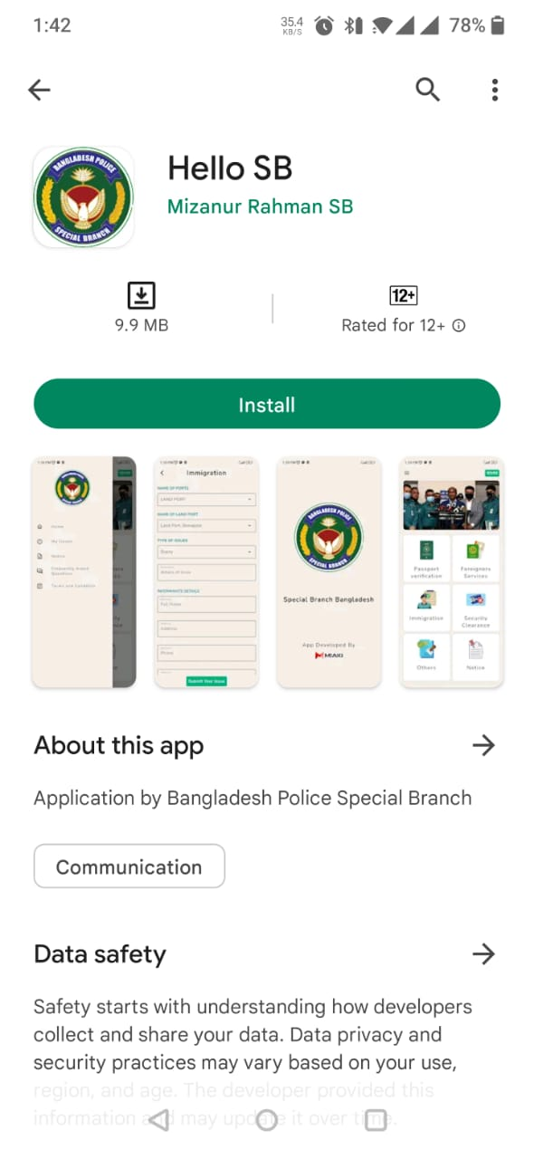
Installation
Special Branch “Hello SB” App is user-friendly & compatible with all Android devices.
“Hello SB” App can be downloaded from Google Play Store
Android phones
Android tablets
App URL
https://play.google.com/store/apps/details?id=com.miaki.hellosb

Slide 4
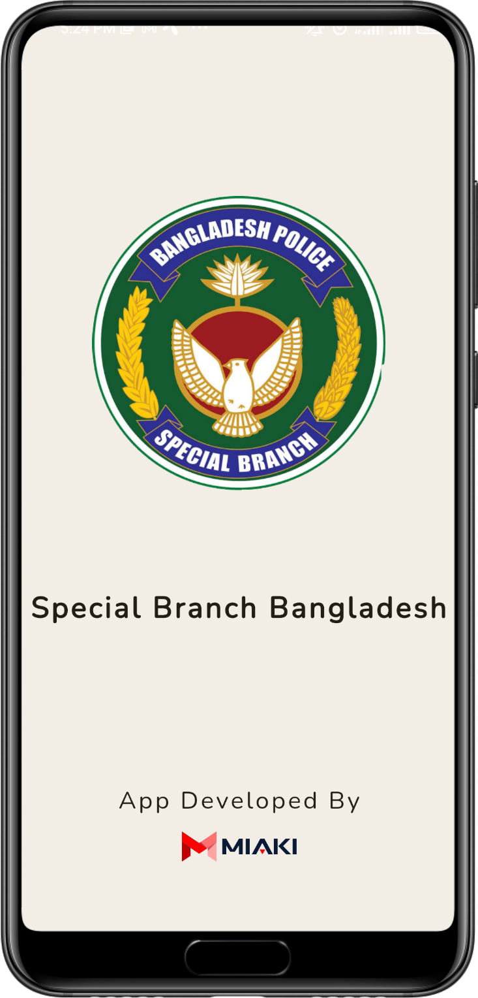
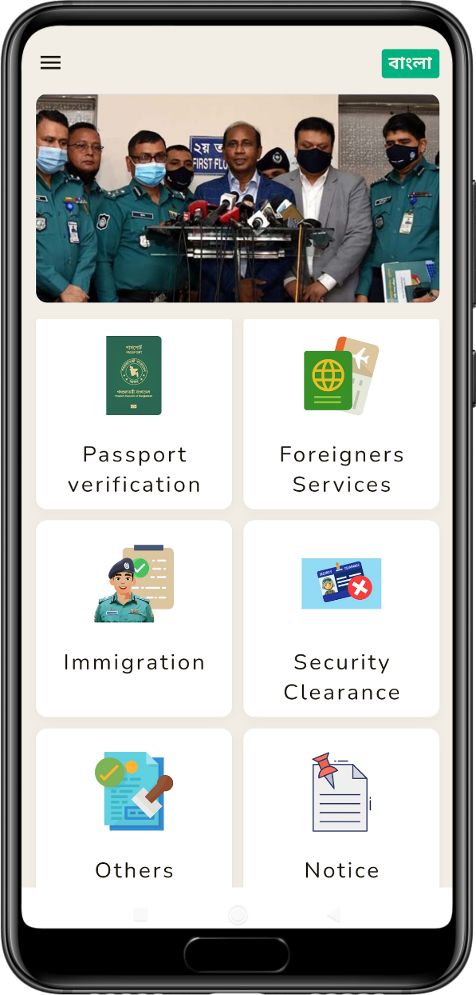
Installation Process
Step
01
Go to Google Play Store.
Step
02
Download “Hello SB” app.
Step
03
Install “Hello SB” app.
Step
04
Choose your desire segment for queries
Step
05
Submit with required documents (if any)

Slide 5
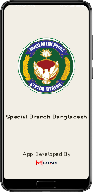
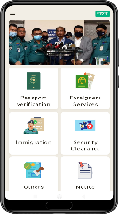
User Journey
2
4
3
Step
01
Google Play
Download App
Step
02
1
Install & Open App
Step
03
7
Step
04
App User
8
Upload Document
5
Step
05
Submit
Issue
Step
6/7
Select Issue
6
Step
08
Input of Information

Slide 6
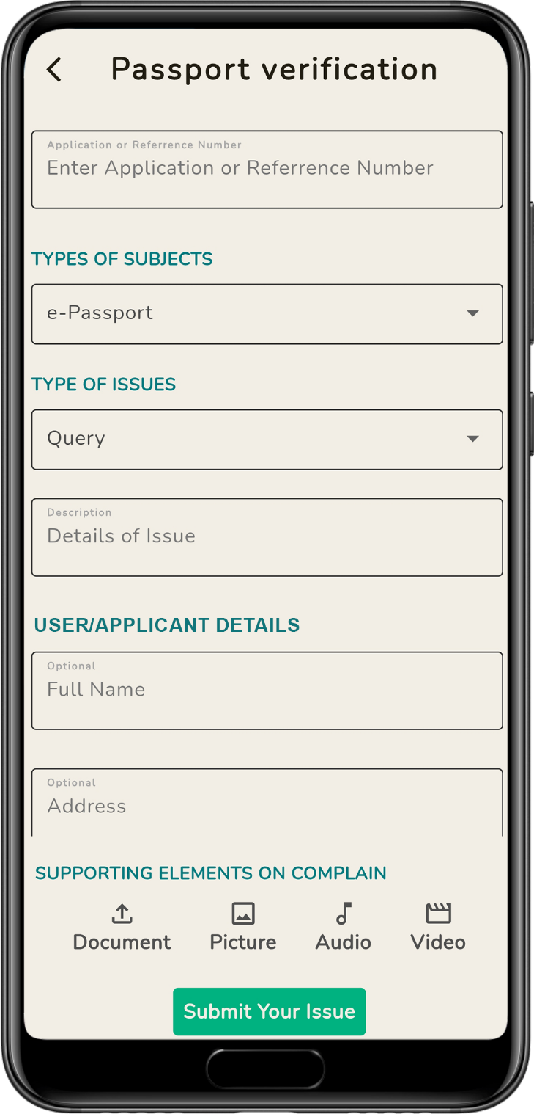
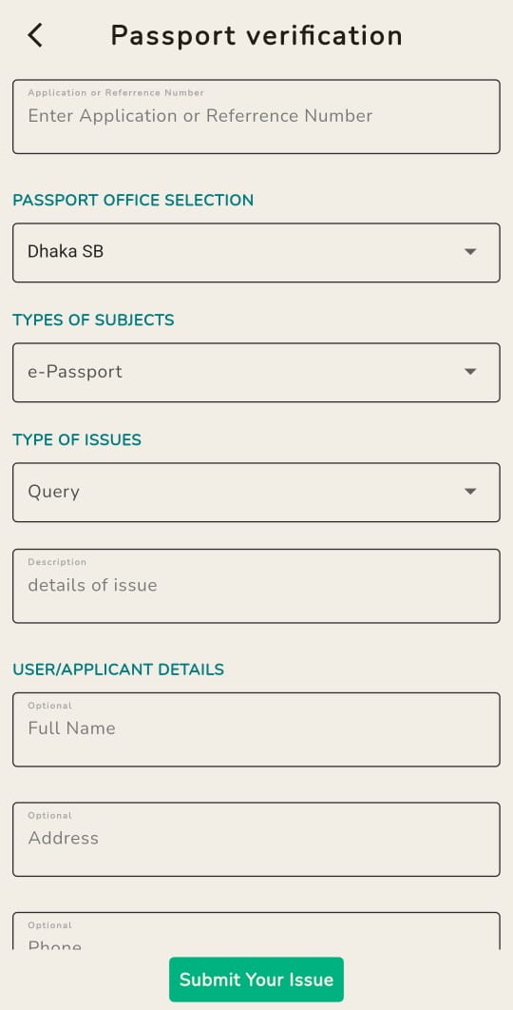
Passport Verification
Function
User can submit queries or complaints regarding Passport related issues like verification status, reason for delay or even can submit any sort of complaint or queries.
Application/Reference Number
SB | DSB | CSB
Name of Office:
Subject:
e-Passport | MRP | Correction
Types of Issue:
Queries | Complaints | Delay/Status
How it Works:
User needs to fill up the form with all necessary information like Application Reference Number, Type of Subject, Type of issue & details of issue. The User/Applicant can also provide his/her Name, Address, Mobile Number & email.
User may submit Supporting Documents, Photos, Audios or Videos.
Steps:
Open SB app > Tap Passport Verification > Fill up the form > Upload documents > Submit

Slide 7
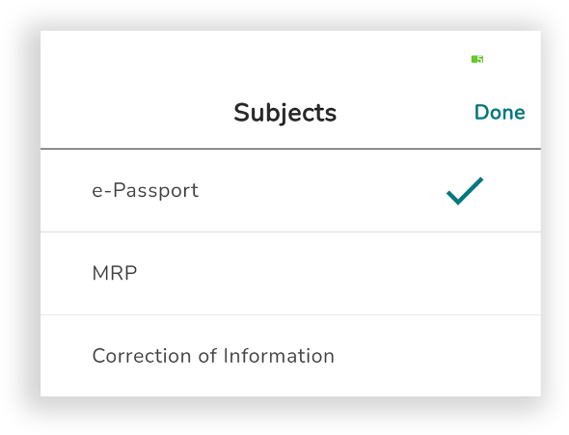
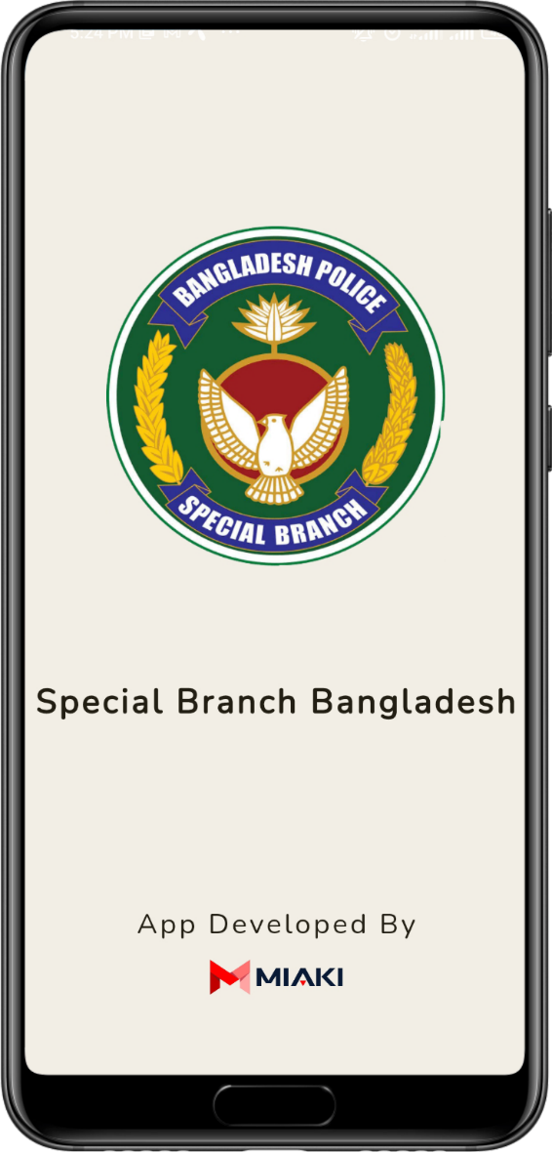
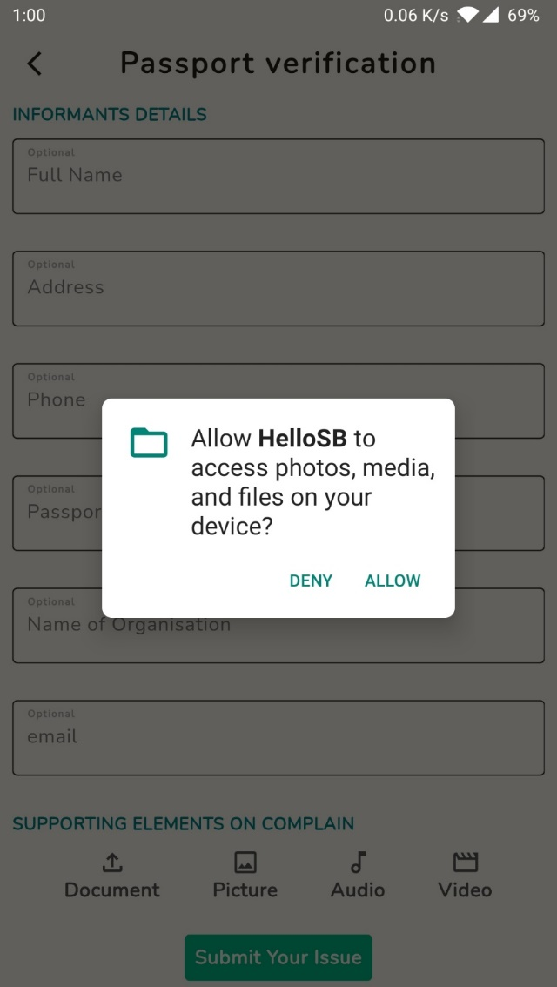
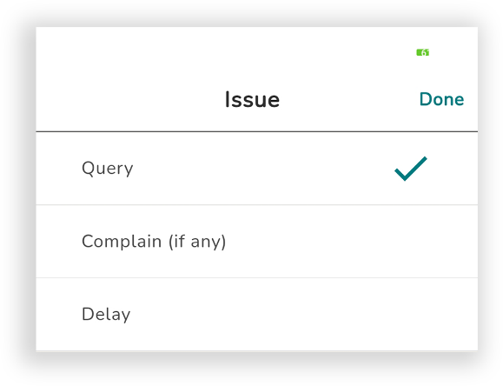
Passport Verification
Tap Passport Verification > Fill up the form > Upload documents > Submit

Slide 8
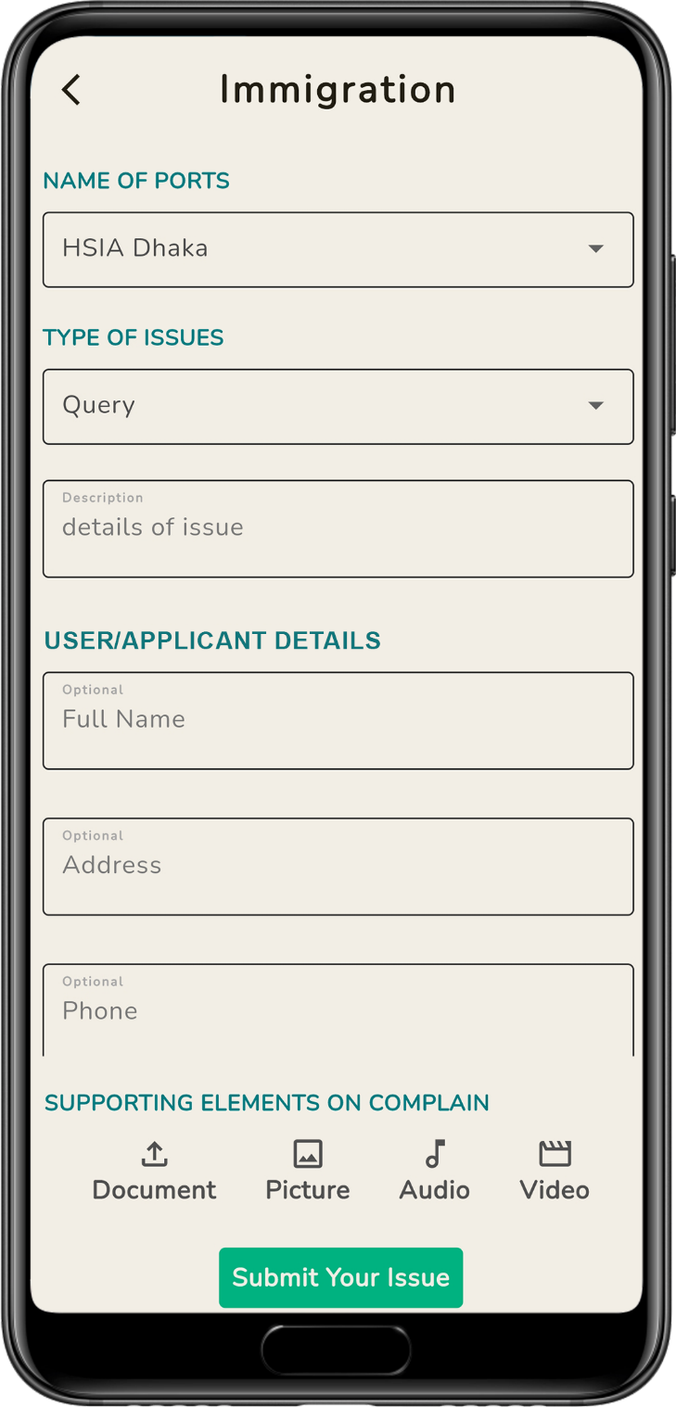
Immigration
Function
User can submit queries or complaints regarding Immigration related issues by choosing concerned port from the list of value.
Name of the Ports:
Airports | Land ports | Sea ports
Types of Issues:
Queries | Complaints | Suggestion/Observation
How it Works:
User needs to fill up the form with all necessary information like Name of the Port, Type & details of issue. The User/Applicant can also provide his/her Name, Address, Mobile Number & email.
User may submit Supporting Documents, Photos, Audios or Videos.
Steps:
Open SB app > Tap Immigration > Select Port > Fill up the form > Upload documents > Submit

Slide 9
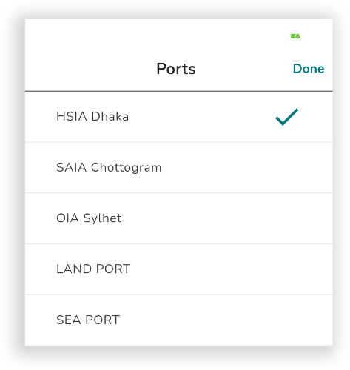
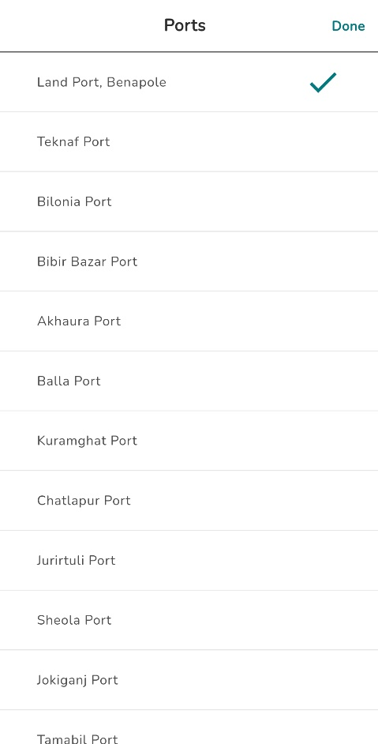
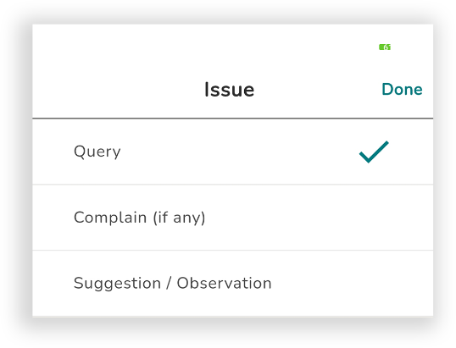
Immigration
Tap Immigration > Fill up the form
> Upload documents > Submit

Slide 10
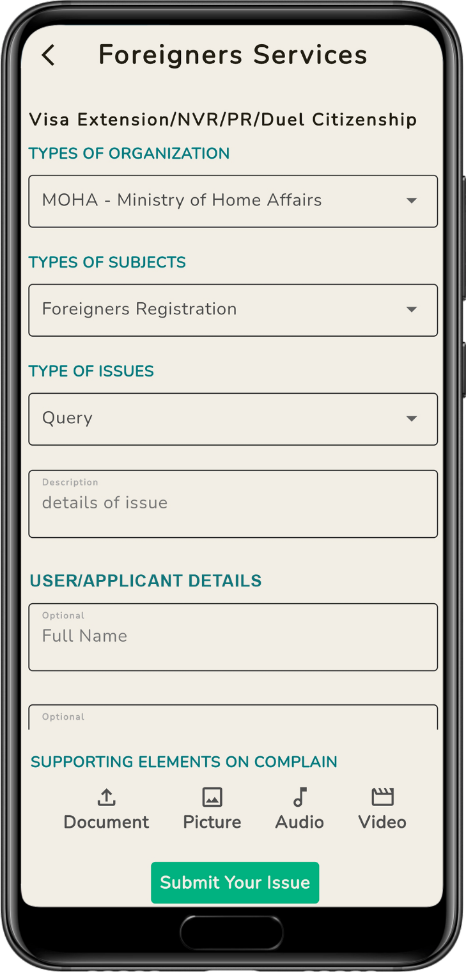
Foreigners Services
Function
User can submit queries or complaints regarding Foreigners Registration, Dual Citizenship & VISA Inquiries
Organization:
MOHA | MOFA | PHQ | DIP | Others
Subject:
Dual Citizenship | VISA Issue/Extension | Registration | NVR
Types of Issue:
Queries | Complaints | Suggestion/Observation
How it Works:
User needs to fill up the form with all necessary information like Type of organization, Type of Subjects, Types & details of issue. The User/Applicant can also provide his/her Name, Address, Mobile Number & email.
User may submit Supporting Documents, Photos, Audios or Videos.
Steps:
Open SB app > Tap Foreigner Services > Fill up the form > Upload documents > Submit

Slide 11
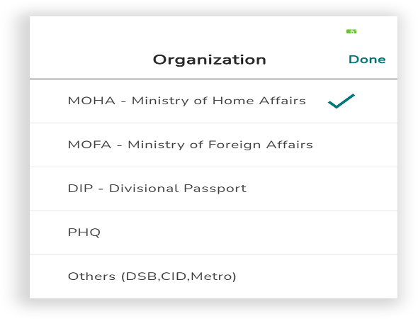
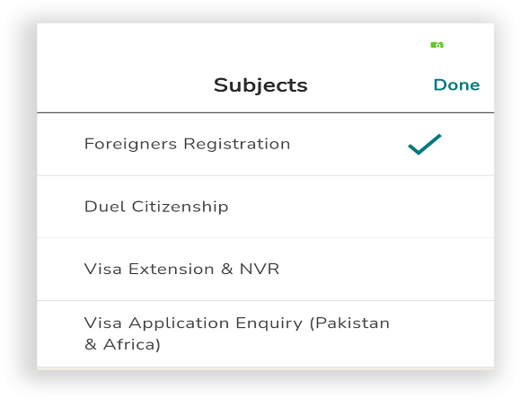
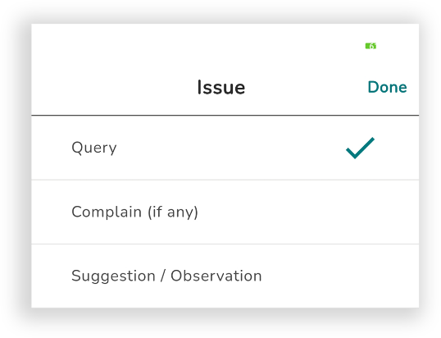
Foreigners Services
Tap Foreigners Services > Fill up the form
> Upload documents > Submit

Slide 12
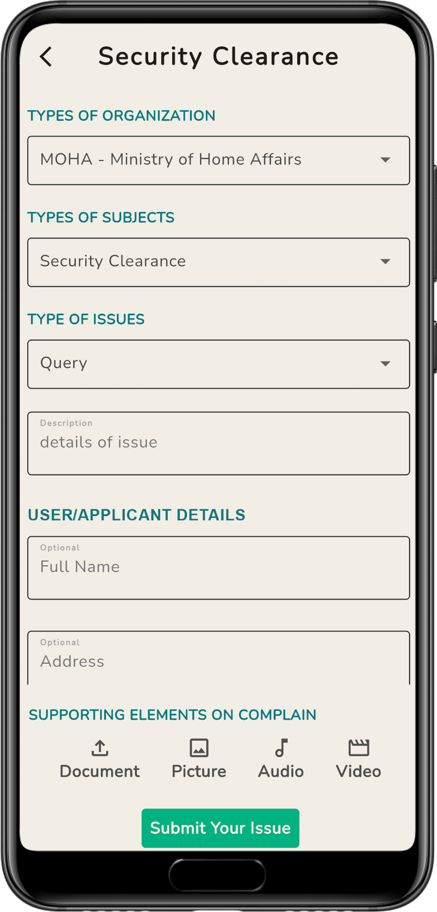
Security Clearance
Function
User can submit Security Clearance related issues like PC&PR, NGO, Hill Track movement Clearances, Frequency Allocation & Different Clearances related to Public Media.
Organization:
MOHA | MOFA | NGO Affairs Bureau | Others
Subject:
Security Clearance | PC/PR | NGO | Adaption | Travel to Hill Tracks
Types of Issue:
Queries | Complaints | Suggestion/Observation
How it Works:
User needs to fill up the form with all necessary information like Type of organization, Type of Subjects, Types & details of issue. The User/Applicant can also provide his/her Name, Address, Mobile Number & email.
User may submit Supporting Documents, Photos, Audios or Videos.
Steps:
Open SB app > Tap Security Clearance > Fill up the form > Upload documents > Submit

Slide 13
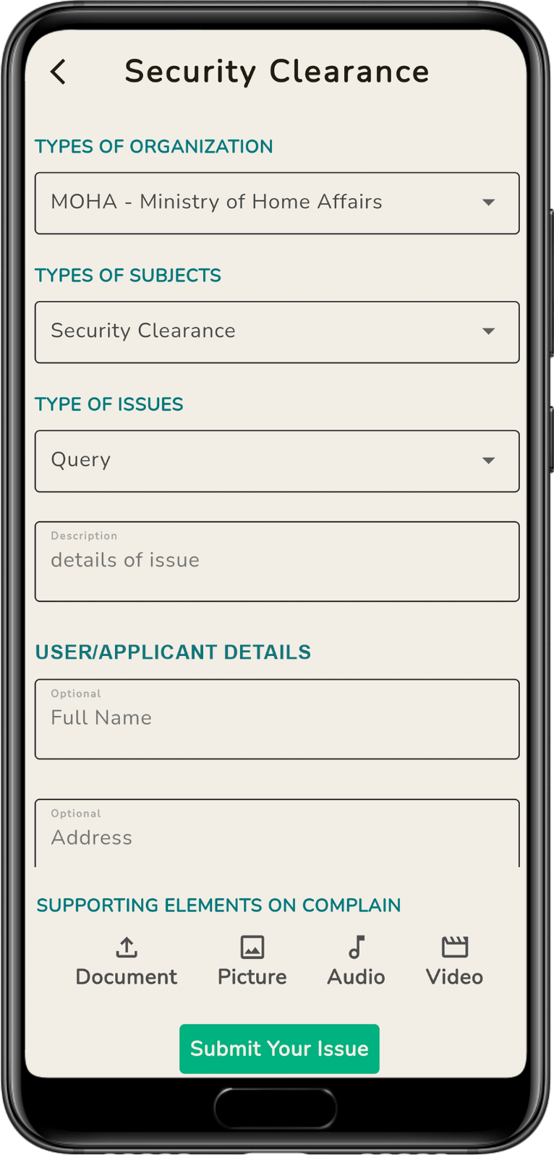
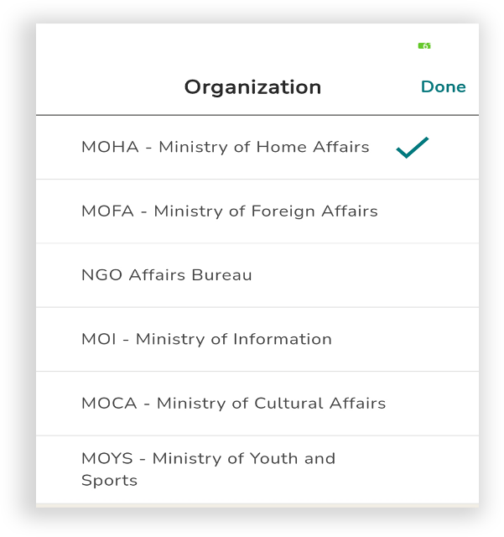
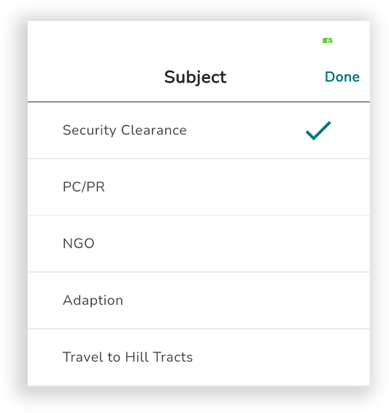
Security Clearance
Tap Security Clearance > Fill up the form
> Upload documents > Submit

Slide 14
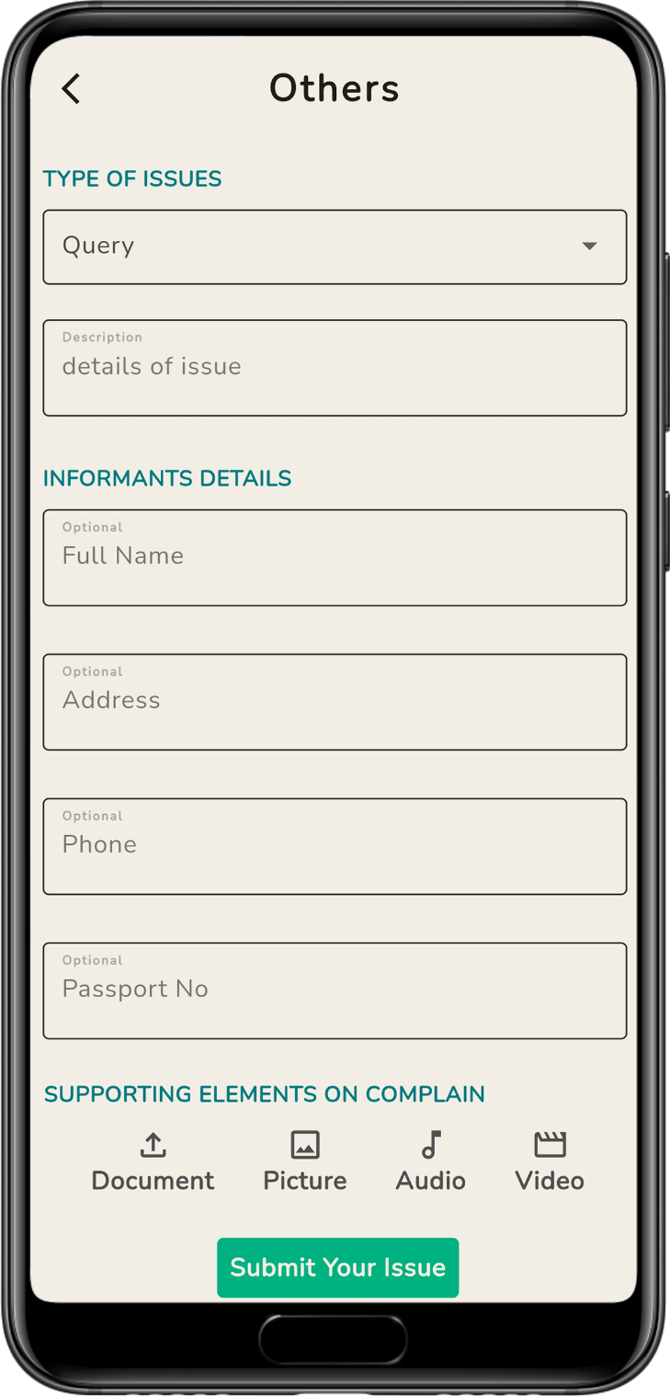
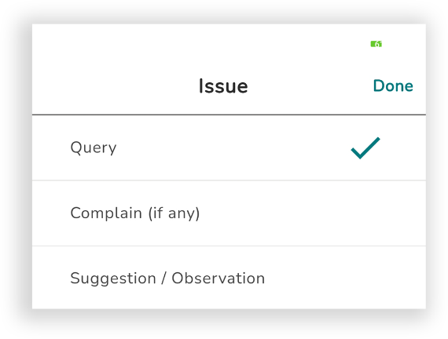
Others
Function
User can submit queries or complaints regarding Other issues excluding the mentioned sections
Type of Issues:
Queries | Complaints | Suggestion/Observation
How it Works:
User needs to fill up the form providing all necessary information & his/her Name, Address, Mobile Number & email.
User may submit Supporting Documents, Photos, Audios or Videos.
Steps:
Open SB app > Tap Immigration > Select Port > Fill up the form > Upload documents > Submit

Slide 15
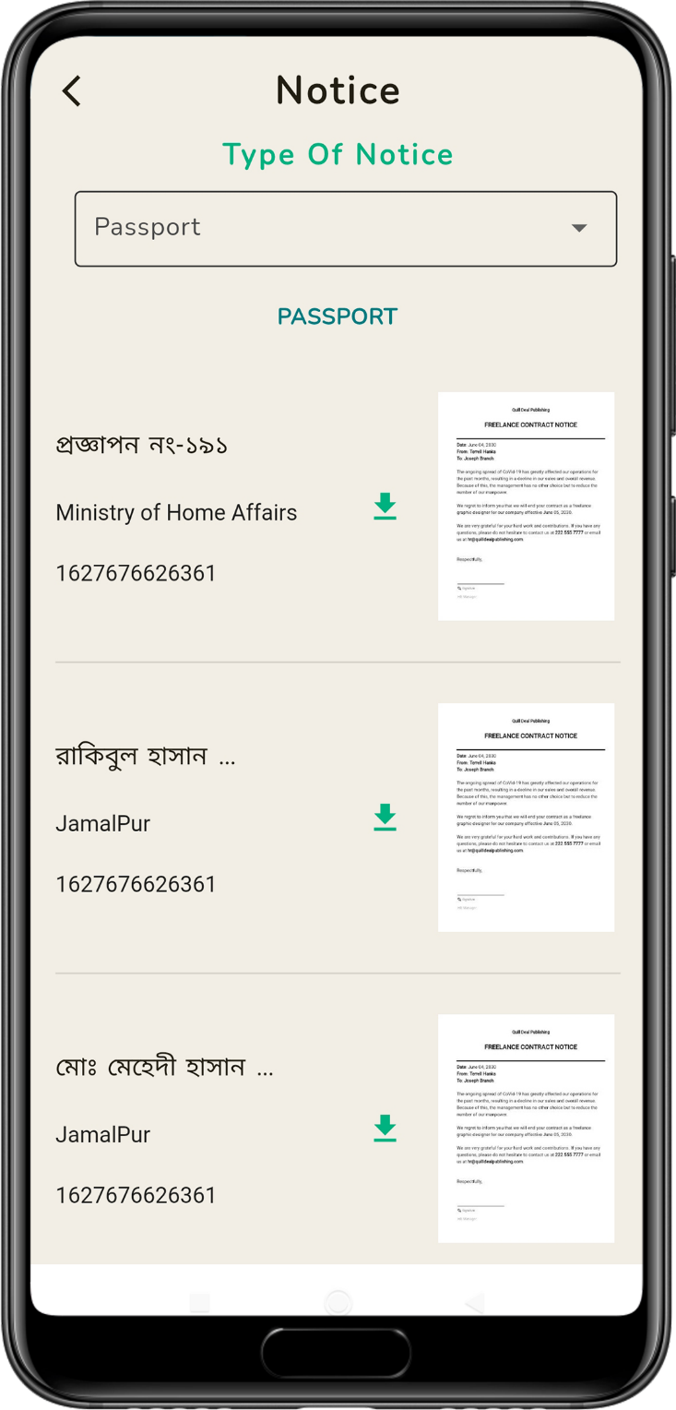
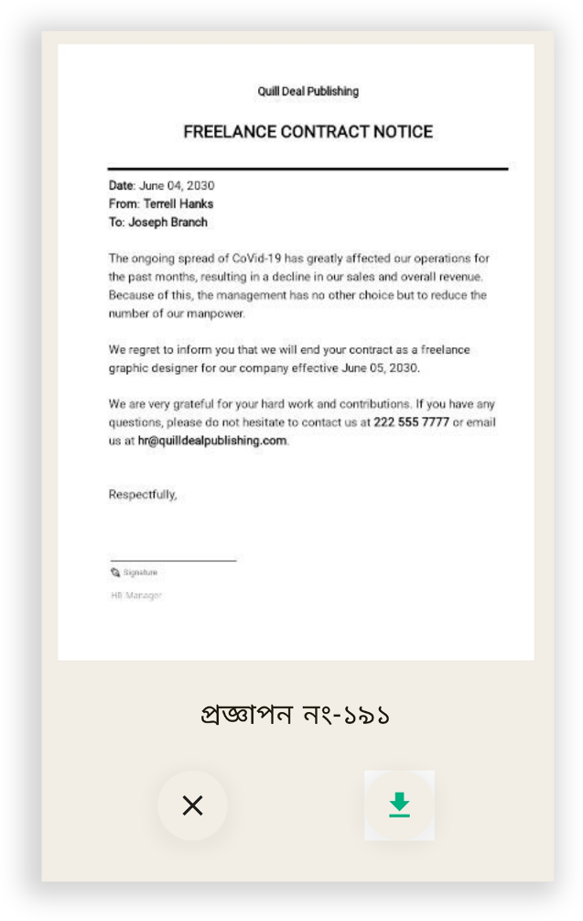
Notice
Type of Notice
The purpose of the this segment “NOTICE” is to provide Information about Latest Rules, Regulations, Circulars & Concerned laws on:
Passport Verification
Foreigners Services
Immigration
Security Clearance

Slide 16
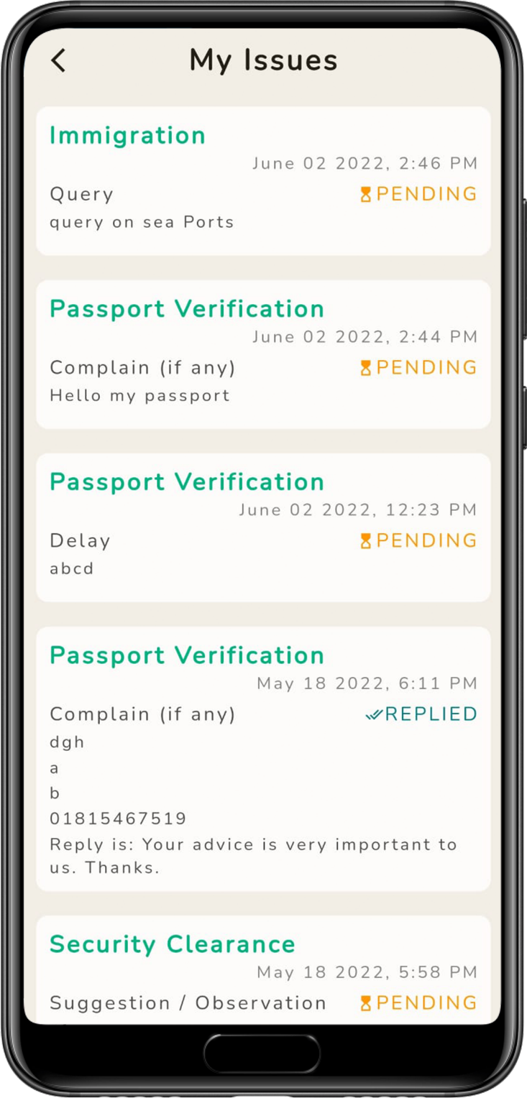
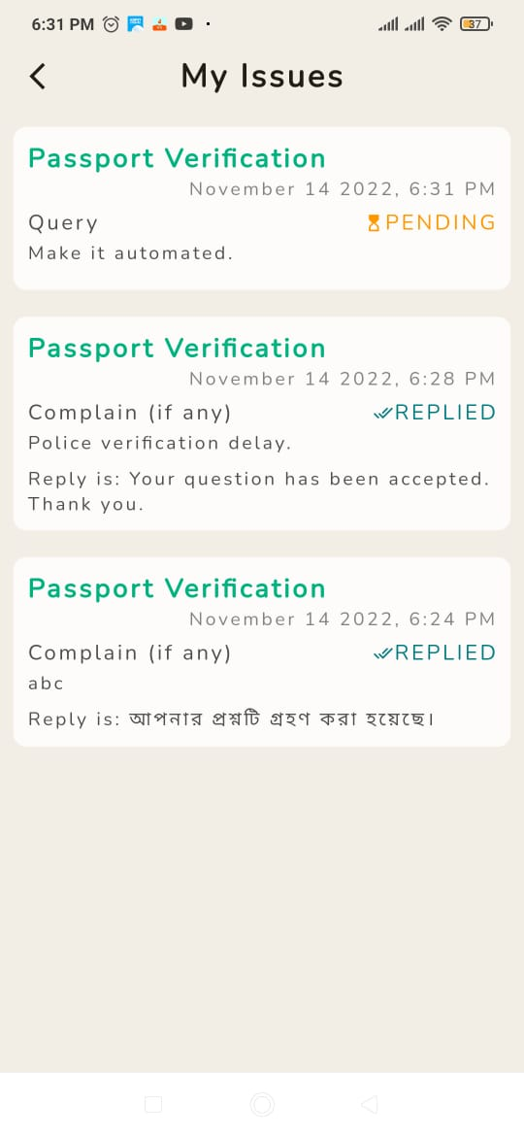
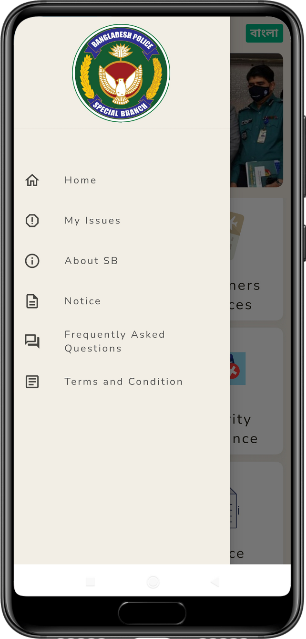
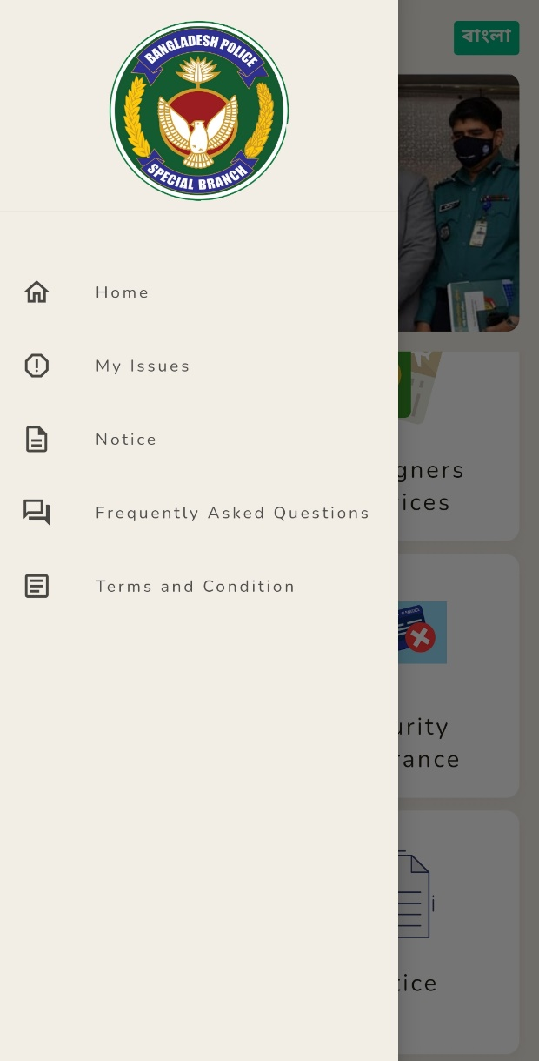
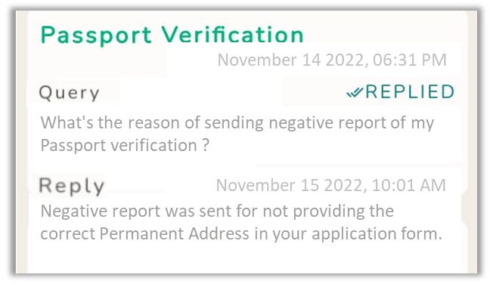
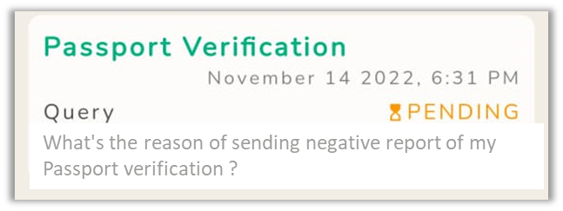
My Issues
Feedback of Submitted Issues
In this part the user can see the issues s/he submitted through SB app.
Example:
What's the reason of sending negative report of my Passport verification ?
November 14 2022, 06:31 PM
What's the reason of sending negative report of my Passport verification ?
November 15 2022, 10:01 AM
Negative report was sent for not providing the correct Permanent Address in your application form.

Slide 17
Thank You
HELLO SB
is a commitment
to ensure
better services

